Slide 1

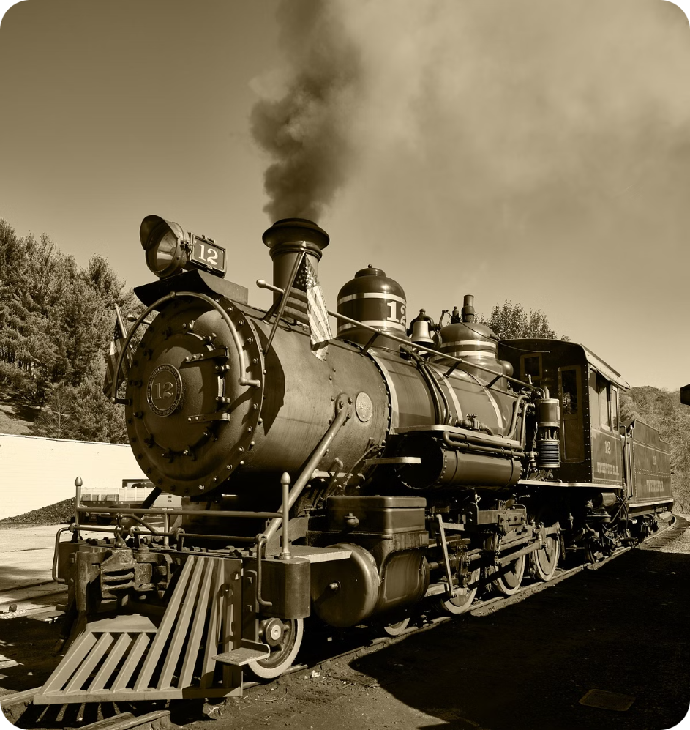
The Steam Engine
The steam engine, a groundbreaking invention of the Industrial Revolution, transformed heat energy from steam into mechanical power, revolutionizing transportation, manufacturing, and society.

Slide 2


Origins and Evolution of Steam Engines
1
Ancient Beginnings
Early concept: Hero's Aeolipile (1st century AD) – a primitive steam-powered device. Use in scientific experiments, but not yet practical for industrial use.
2
Industrial Revolution and Early Prototypes
17th century: Thomas Savery developed the first practical steam pump (1698) to remove water from mines. 1712: Thomas Newcomen's atmospheric steam engine – a significant step toward more efficient steam use. Transition from simple pumps to more powerful engines.

Slide 3
James Watt and the Birth of Modern Steam Engines
Watt's Innovations
Impact on Industry and Society
In the 1760s, James Watt revolutionized steam engines with a separate condenser, increasing efficiency. Introduction of the rotary motion engine, allowing steam engines to power machinery beyond pumping water.
Factories and textile mills: Steam engines replaced water wheels, allowing factories to operate anywhere, not just near rivers. Transport and urbanization: Steam engines powered the growth of cities, factories, and railroads. The Watt engine became a symbol of the Industrial Revolution's mechanical advancement.

Slide 4

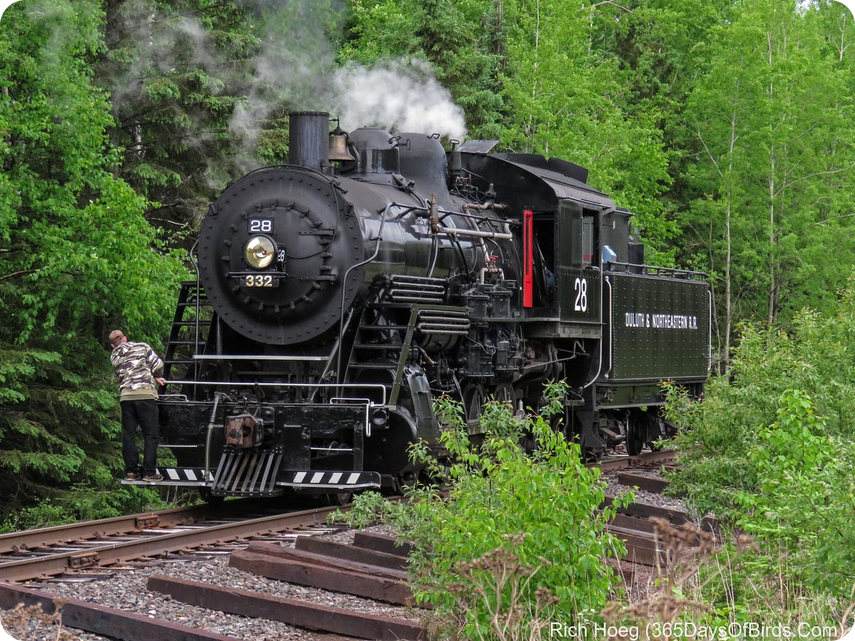
Steam Power in Transportation: Railways
1
1804: Richard Trevithick's Steam Locomotive
Richard Trevithick's steam locomotive paved the way for trains.
2
1829: George Stephenson's Rocket
George Stephenson's Rocket locomotive – an engineering milestone in efficient rail transport.
3
19th Century Railway Expansion
Railroads became the backbone of 19th-century transportation, moving goods and people over vast distances.

Slide 5

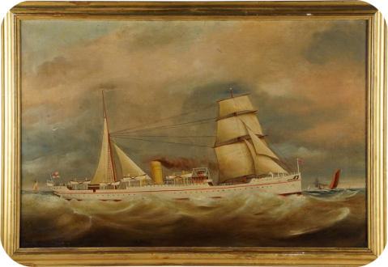
Steam Power in Transportation: Steamships
Early 1800s Introduction
Impact on Global Trade
Exploration
Introduction of steam-powered ships, enabling longer voyages without reliance on wind.
Steamships facilitated the movement of people, resources, and goods across oceans.
Steamships enabled new possibilities for global exploration and trade routes.

Slide 6


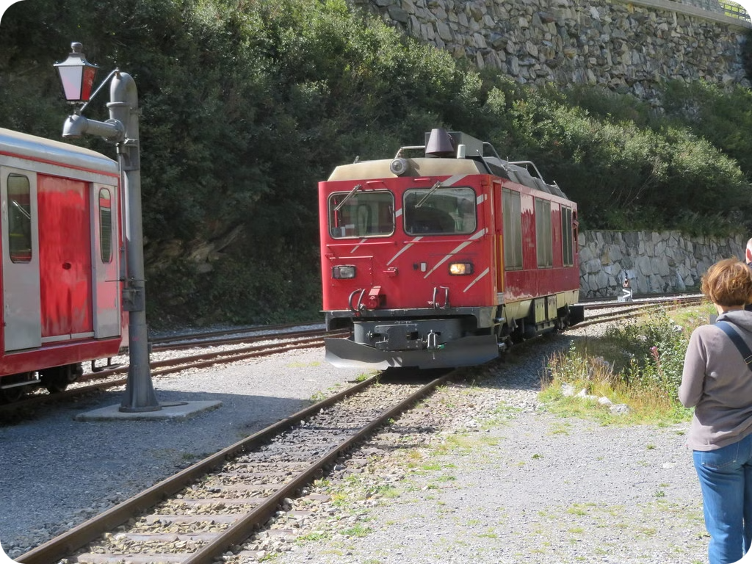


Challenges and Decline of Steam Engines
20th Century Transition
Diesel and electric engines began to replace steam engines due to efficiency, speed, and ease of use.
Limited Use
Steam engines remained in limited use, but their prevalence decreased significantly.
1950s Phase-Out
By the 1950s, most steam engines were phased out in favor of newer technologies.

Slide 7

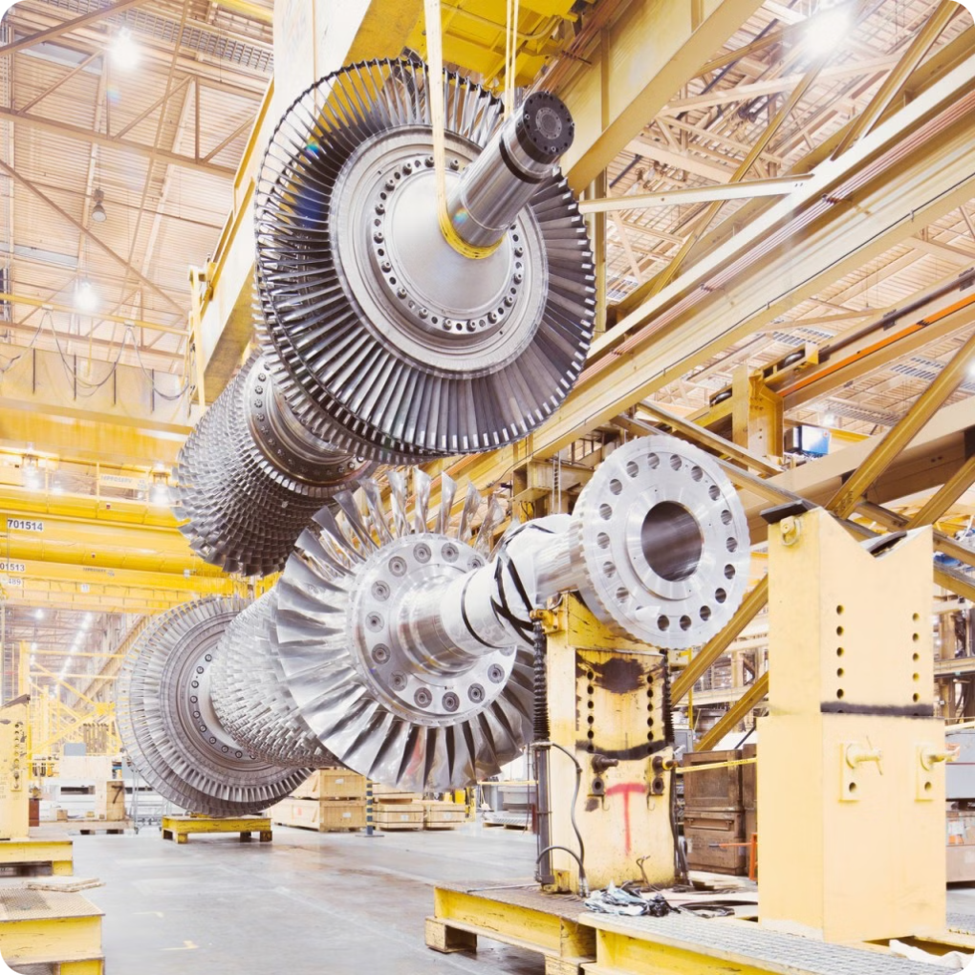



Legacy and Impact of Steam Engines
Engineering Advancements
Steam engines paved the way for thermodynamics and mechanical engineering advancements.
Historical Preservation
Preserved as historical artifacts and in museums, with some operational models for tourism and educational purposes.
Modern Power Generation
Steam engines laid the groundwork for modern power generation, from coal-fired to nuclear and hydroelectric plants.

